Slide 1
Climatic change
And health problems
By: Hugo García & Óscar Freire

Slide 3
Index
Climatic Change
Kyoto Protocol
Climatic variations
Health consequences
Continue

Slide 4
Climatic change
In summary like we know climatology is more complex than we think. The changes observed in the past and the ones observed in the present are really interesting. Something is changing. The actual climate will change in the next years, with a higher speed owing to the human activities. There are more extreme meteorological phenomena like: hurricanes, tsunamis, earthquakes, volcanoes, intense storms and floods.

Slide 6
Climatic Change
There are many theories about climatic change. Ones say that we are going to have a progressive global warming, based on the increasing of the temperatures , the greenhouse effect caused by the increase of CO2 and the depletion of the ozone layer. Other say that is based on the change of the submarine currents, the diminution of solar spots and the increase of precipitations in the north hemisphere.
The scientifics have been warned us from a long time ago, and now the governments are more interested, because the economy is being altered, and the catastrophes cause more human deaths.

Slide 7
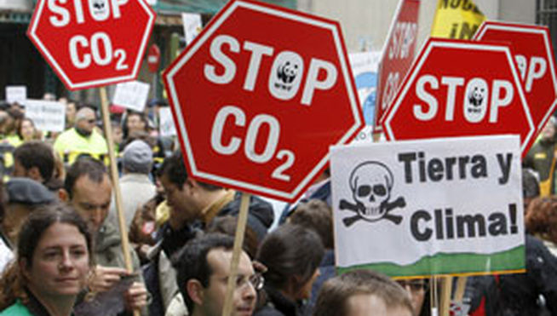
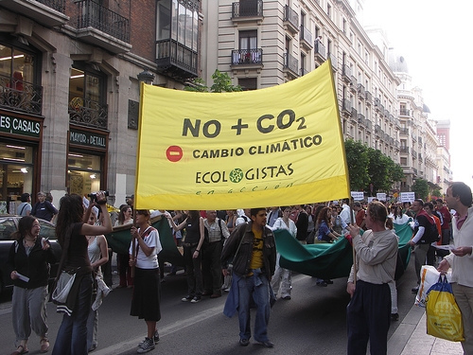
Return

Slide 8
Kyoto Protocol
The Kyoto Protocol is a protocol to the United Nations Framework Convention on Climate Change (UNFCCC or FCCC), aimed at fighting global warming. The UNFCCC is an international environmental treaty with the goal of achieving the stabilisation of greenhouse gas concentrations in the atmosphere at a level that would prevent dangerous anthropogenic interference with the climate system.

Slide 9
Objectives
These are the main three objectives in kyoto’s protocol:
Reduction of greenhouse effect. This is the most important one, making a lot of countries reducing their emissions of greenhouse effect gases.
Minimizing impacts on poor countries by establishing an adaptation fund for climate change.
Accounting, reporting and reviewing in order to ensure the integrity of the Protocol.

Slide 10
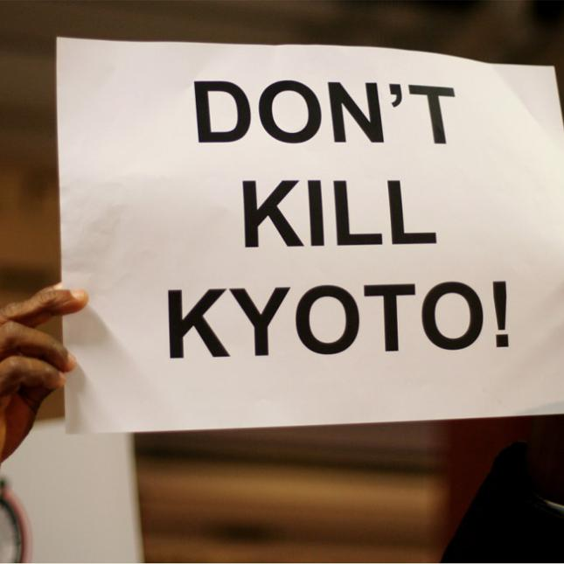
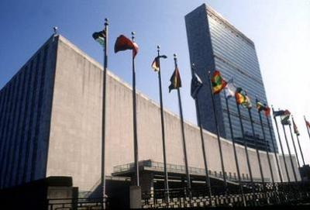
Return

Slide 11
Climatic variations
Here we will see, how the greenhouse effect and with it the climatic change, are really changing the earth climate, by increasing the temperatures and the precipitations in the north hemisphere.

Slide 12
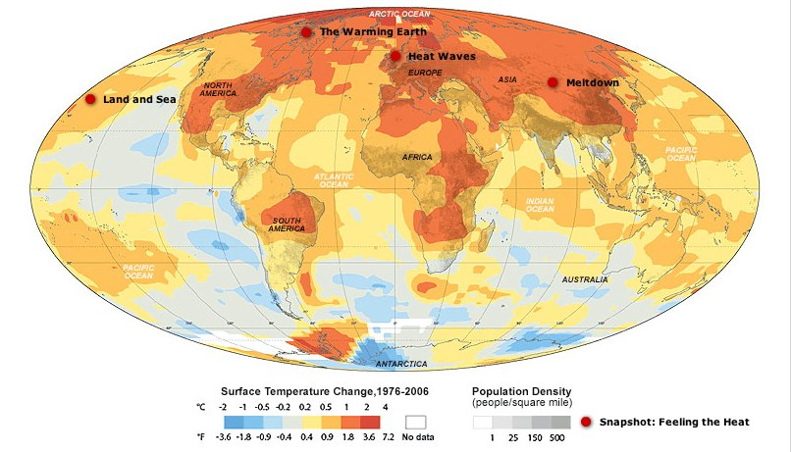
In this first map we see how the global temperature, increased in almost every part of the world in recent years. And in a lot of places increased around 4 degrees!

Slide 13
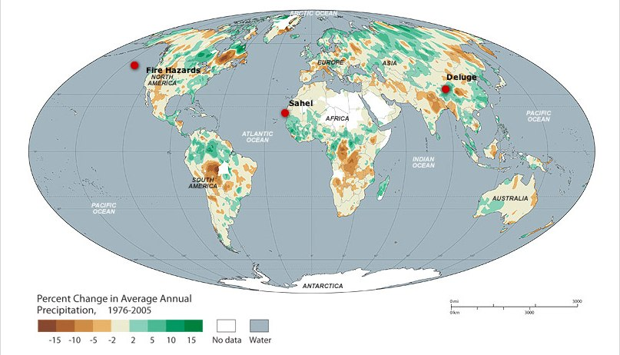
In the second one wee se how the precipitations increased a lot in the north hemisphere, and also in the equatorial zones, in this recent years.
Return

Slide 14
Health consequences
So, why do we care about this? I would like Galicia to be a hottest place, but this changes will affect to our health. How? Let’s see.
The changes in the temperature, the humidity, the rainfall and the increase of the water level can affect in the apparition of infectious diseases. The mosquitoes, ticks and fleas are sensible to the changes in the temperature and humidity. This recent years many infectious diseases appeared again in countries with particular climate conditions.
One of this is the malaria or paludism wich we will speak about now.

Slide 15
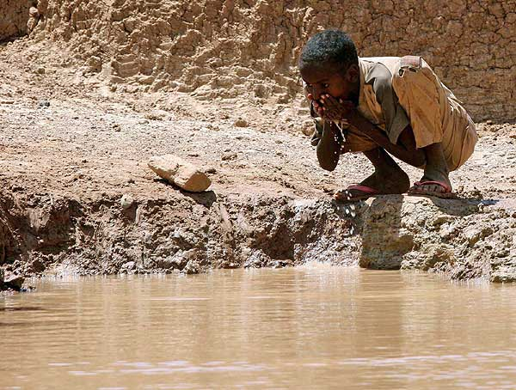
Health Consequences
Water-related Diseases
The warm temperatures of the sea surface promote algae growth, that may be associated with cholera epidemics. The incidence of cholera in Bangladesh in the early years of the last half century (1893-1940) did not correlate with the phenomenon of El Niño, although in recent years of the twentieth century (1980-2001) the relationship was evident, consistent with the times when there were more events related to it.

Slide 16
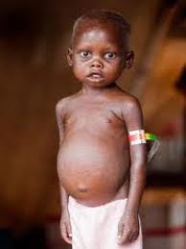
Health Consequences
Malnutrition
Studies on the effects of climate change on food production suggest that cereal crops are likely to increase in mid-latitude regions or high, but decreased in the lower latitudes. In particular, there is concern that climate change may adversely affect nutrition in Africa, mainly due to increased drought.

Slide 17
Health Consequences
Allergens
Mild winters may cause an earlier onset of pollination, so the concentrations of the various allergens produced by this phenomenon, might be increased. Furthermore, it has been shown that increasing the values ​​of carbon dioxide increases the time and the release of biogenic allergens (eg, particulate laundry), both indoors and studies in situ. Thus, climate change may increase the incidence of allergic rhinitis, the intensity and duration of symptoms, or both

Slide 18
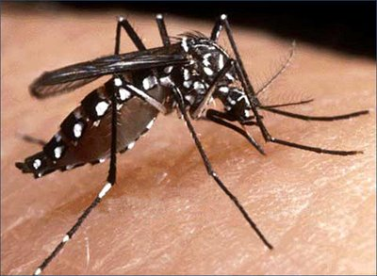
Health Consequences
Dengue
The rate of dengue virus replication in the mosquito Aedes aegypti in the laboratory directly increases with increasing temperature. If the investigations are correct, projections with future climate change suggest that temperature will relatively increase small in temperate regions, due to the introduction of the virus in a susceptible human population could increase the potential risk of epidemics.

Slide 19
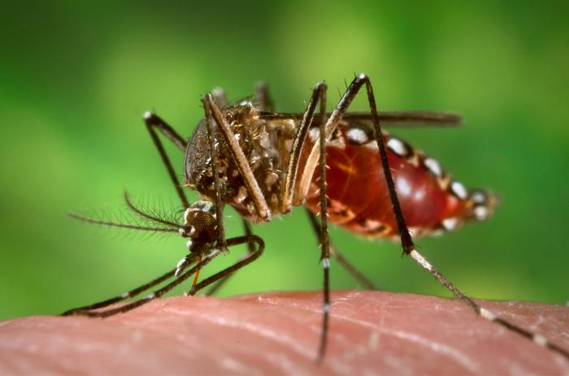
Health Consequences
Leishmaniasis
Leishmaniasis has emerged as an important co-infection in patients infected with human immunodeficiency virus in southern Europe and parts of Asia. There may be differences between the vectors in susceptibility to climate change. For example, a study in Italy suggested that climate change could have expanded the range of a vector and may have decreased another one. Climate change could increase the geographical distribution of vectors in regions of Latin America and Southwest Asia.

Slide 20
Health Consequences
Malaria
Climate change may contribute to the resurgence of malaria in areas where public health infrastructures have become defective (eg., Central Asia and southern areas of the former Soviet Union). In regions where malaria has been removed locally, although the vector persists, there is a theoretical risk (reduced), they appear localized outbreaks, which could increase due to climate change.?This is an issue that causes a high dispute and will continue to improve our knowledge by further investigations.

Slide 21
Malaria Transmission Cycle

Slide 22
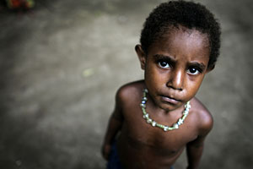
Health Consequences
Malaria death rate
Every year between 700.000 and 2.7 millions of people die of malaria or paludism. The most of them (76%), are children in endemic zones of Africa. Most of the cases occur in the Sahara zones. Each year 396 millions of paludism cases occur. The average is about 1.3 millions of deaths annually, which a 90% are children under 5 years.

Slide 23
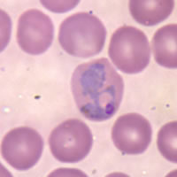
Health Consquences
Plasmodium parasite
Like we all know malaria is caused by the plasmodium parasite, that is hosted in the mosquitoes of the Anopheles gender. This parasite is a gender of protist which we know more than 175 species. This parasite always has two hosts: the mosquito that acts like a vector and the vertebrate host. There are 10 species which infect human beings, but only four that produce malaria: P. falciparum, P. malarie, P. ovale e P. vivax. Between all of them the first one is the worst.
Return

Slide 24
Climatic Change
Óscar Freire Agulleiro
Hugo García Crende
1ºBach B

